Slide 1
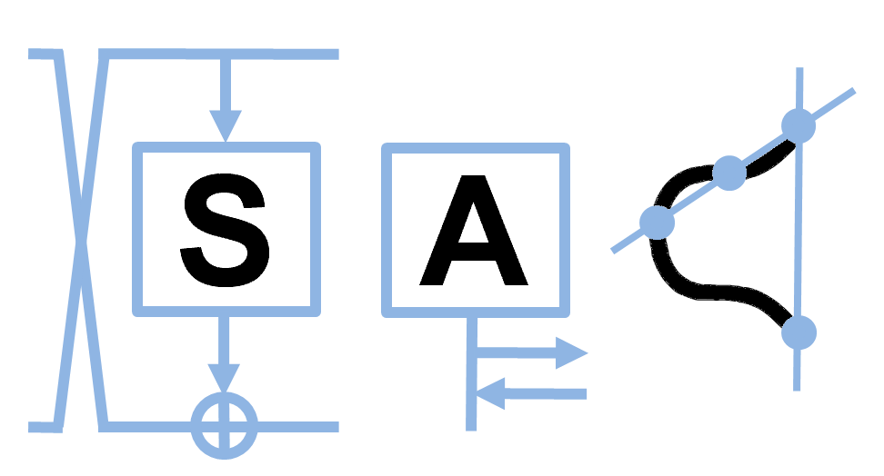
Fast and Efficient Hardware Implementation of HQC
Sanjay Deshpande*, Chuanqi Xu*, Mamuri Nawan⁺, Kashif Nawaz⁺, and Jakub Szefer*
*Computer Architecture and Security Lab, Yale University
⁺Cryptography Research Centre, Technology Innovation Institute
Selected Areas in Cryptography 2023

Slide 2
Outline
Motivation
Introduction
Goal and Existing work
Components in HQC and their Hardware Implementation
Comparison with Related State of the Art

Slide 3


Motivation
Quantum Computers with sufficient Qubits will be able to solve practical problems.
Two algorithms are of special interest for cryptography community:
Shor’s Algorithm
Grover’s Search Algorithm
For example, to break a 2048-bit RSA, a perfect quantum computer with 4099 ideal qubits can do it in 10 seconds.
Most recently, IBM announced 433-qubits quantum computer “Osprey”.
There is a need for Quantum-safe Cryptography!
Image Source: MIT Technology Review
Source: https://www.quintessencelabs.com/blog/breaking-rsa-encryption-update-state-art/
Source: https://newsroom.ibm.com/2022-11-09-IBM-Unveils-400-Qubit-Plus-Quantum-Processor-and-Next-Generation-IBM-Quantum-System-Two

Slide 4
Post Quantum Cryptography Competition
51 hash functions
➝ 1 winner
2007
2012
Completed
SHA-3
In Progress
2013
2019
57 authenticated ciphers
➝ multiple winners
CAESAR
XII.2016
TBD
69 Public Key Post Quantum Cryptography Schemes
Post-Quantum
2018
2023
56 Lightweight authenticated ciphers & hash functions
Lightweight
07
08
09
10
11
12
13
14
15
16
17
18
19
20
21
22
23
Year
Kris Gaj, Implementation and Benchmarking of Round 2 Candidates in the NIST Post-Quantum Cryptography Standardization Process Using FPGAs, NIST Seminars, Oct 2020.

Slide 5
Post Quantum Cryptography Competition
51 hash functions
➝ 1 winner
2007
2012
Completed
SHA-3
In Progress
2013
2019
57 authenticated ciphers
➝ multiple winners
CAESAR
XII.2016
TBD
Round 4 announced
1 candidate selected for standardization
4 candidates will undergo further evaluation
69 Public Key Post Quantum Cryptography Schemes
Post-Quantum
2018
2023
56 Lightweight authenticated ciphers & hash functions
Lightweight
07
08
09
10
11
12
13
14
15
16
17
18
19
20
21
22
23
Year
Kris Gaj, Implementation and Benchmarking of Round 2 Candidates in the NIST Post-Quantum Cryptography Standardization Process Using FPGAs, NIST Seminars, Oct 2020.

Slide 6
Post Quantum Cryptography Competition
51 hash functions
➝ 1 winner
2007
2012
Hash based Crypto
Completed
SHA-3
In Progress
2013
2019
Lattice based Crypto
57 authenticated ciphers
➝ multiple winners
CAESAR
XII.2016
TBD
69 Public Key Post Quantum Cryptography Schemes
Post-Quantum
Code based Crypto
2018
2023
56 Lightweight authenticated ciphers & hash functions
Lightweight
Isogeny based Crypto
Multivariate Crypto
07
08
09
10
11
12
13
14
15
16
17
18
19
20
21
22
23
Year
Kris Gaj, Implementation and Benchmarking of Round 2 Candidates in the NIST Post-Quantum Cryptography Standardization Process Using FPGAs, NIST Seminars, Oct 2020.

Slide 7
Post Quantum Cryptography Competition
51 hash functions
➝ 1 winner
2007
2012
Hash based Crypto
Completed
SHA-3
In Progress
2013
2019
Lattice based Crypto
57 authenticated ciphers
➝ multiple winners
Classic
McEliece
CAESAR
XII.2016
TBD
69 Public Key Post Quantum Cryptography Schemes
Post-Quantum
Code based Crypto
Bike
2018
2023
HQC
(This Work)
56 Lightweight authenticated ciphers & hash functions
Lightweight
Isogeny based Crypto
Multivariate Crypto
07
08
09
10
11
12
13
14
15
16
17
18
19
20
21
22
23
Year
Kris Gaj, Implementation and Benchmarking of Round 2 Candidates in the NIST Post-Quantum Cryptography Standardization Process Using FPGAs, NIST Seminars, Oct 2020.

Slide 8





Key Encapsulation Mechanism
Public Key
(PK, SK)←KeyGen(seed)
PK
Encapsulated Key
Secret Key
C
(K, C)←Encap(PK)
K←Decap(SK, C)
Ciphertext
Decapsulated Key
Secure Channel
Symmetric Encryption
Source: https://iacr.org/cryptodb/data/paper.php?pubkey=31347

Slide 9

Design & Experimental Setup
HQC KEM parameter sets recommended as per the specification:
hqc128
hqc192
hqc256
Target device: Xilinx - Artix 7 – xc7a200t-3 and xc7a100t-3
Tool: Xilinx Vivado 2020.2.2
Verification: Using the Software Reference implementation by HQC team [AAB+20]
Goal: Implement a constant-time hardware design which is parameterizable across
Security level
Performance parameters
Image Source: Xilinx

Slide 10
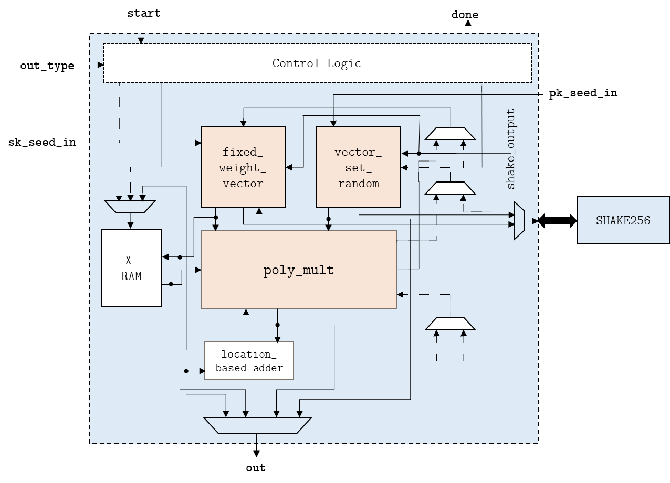
Primitives
1. Key Generation
Fixed weight error vector generation
SHAKE256
Polynomial Multiplication
Polynomial Addition

Slide 11
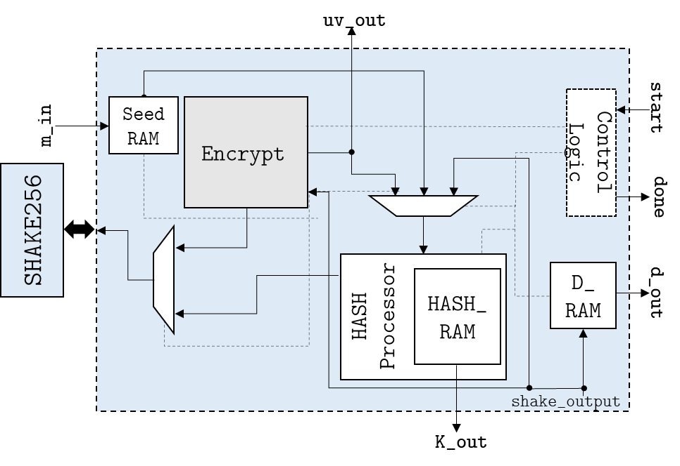
Primitives
2. Encapsulation
Encrypt
Encode
Polynomial Multiplication
Polynomial Addition
Fixed weight error vector generation
SHAKE256
Hash Computation
SHAKE256

Slide 12
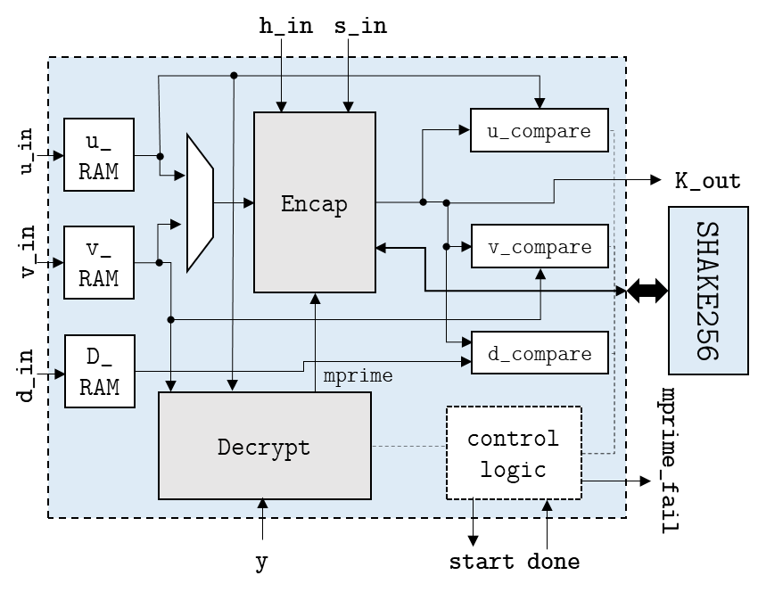
Primitives
3. Decapsulation
Decrypt
Decode
Polynomial Subtraction
Polynomial Multiplication
Encrypt
Hash Computation
SHAKE256
Encapsulation

Slide 13
Primitives – Common Modules
1. Key Generation
Fixed weight error vector generation
SHAKE256
Polynomial Multiplication
Polynomial Addition
3. Decapsulation
Decrypt
Decode
Polynomial Subtraction
Polynomial Multiplication
Encrypt
Hash Computation
SHAKE256
2. Encapsulation
Encrypt
Encode
Polynomial Multiplication
Polynomial Addition
Fixed weight error vector generation
SHAKE256
Hash Computation
SHAKE256

Slide 14
Primitives - Existing Work
1. Key Generation
Fixed weight error vector generation
SHAKE256 [CCD+22]
Polynomial Multiplication
Polynomial Addition
3. Decapsulation
Decrypt
Decode
Polynomial Subtraction
Polynomial Multiplication
Encapsulation
2. Encapsulation
Encrypt
Encode
Polynomial Multiplication
Polynomial Addition
Fixed weight error vector generation
SHAKE256 [CCD+22]
Hash Computation
SHAKE256 [CCD+22]

Slide 15

SHAKE256
Improved existing design [CCD+22].
Added state preserving capability.
Added an extra mode in the performance parameter (Parallel Slices).

Slide 16
Hardware Implementation of HQC KEM
1. Key Generation
Fixed weight error vector generation
SHAKE256
Polynomial Multiplication
Polynomial Addition
3. Decapsulation
Decrypt
Decode
Polynomial Subtraction
Polynomial Multiplication
Encapsulation
2. Encapsulation
Encrypt
Encode
Polynomial Multiplication
Polynomial Addition
Fixed weight error vector generation
SHAKE256
Hash Computation
SHAKE256

Slide 17
Polynomial Multiplication - Sparse Multiplication with Interleaved Reduction
One of the inputs to polynomial multiplier is a sparse fixed weight vector.
Indices of non-zero elements are used to shift non-sparse polynomial to imitate the multiplication.
The multiplication and the modular reduction is interleaved.
n
n
Non-Sparse
Polynomial Input
Variable
Shifter/ Rotation
2n
n
n
n
Output Polynomial
n
Non zero bit position from Sparse Input
*Conceptual Block Diagram

Slide 18
Polynomial Multiplication - Sparse Multiplication with Interleaved Reduction
Sparse
Multiplication
Interleaved
Reduction
One of the inputs to polynomial multiplier is a sparse fixed weight vector.
Indices of non-zero elements are used to shift non-sparse polynomial to imitate the multiplication.
The multiplication and the modular reduction is interleaved.
n
n
Non-Sparse
Polynomial Input
Variable
Shifter/ Rotation
2n
n
n
n
Output Polynomial
n
Non zero bit position from Sparse Input
*Conceptual Block Diagram

Slide 19
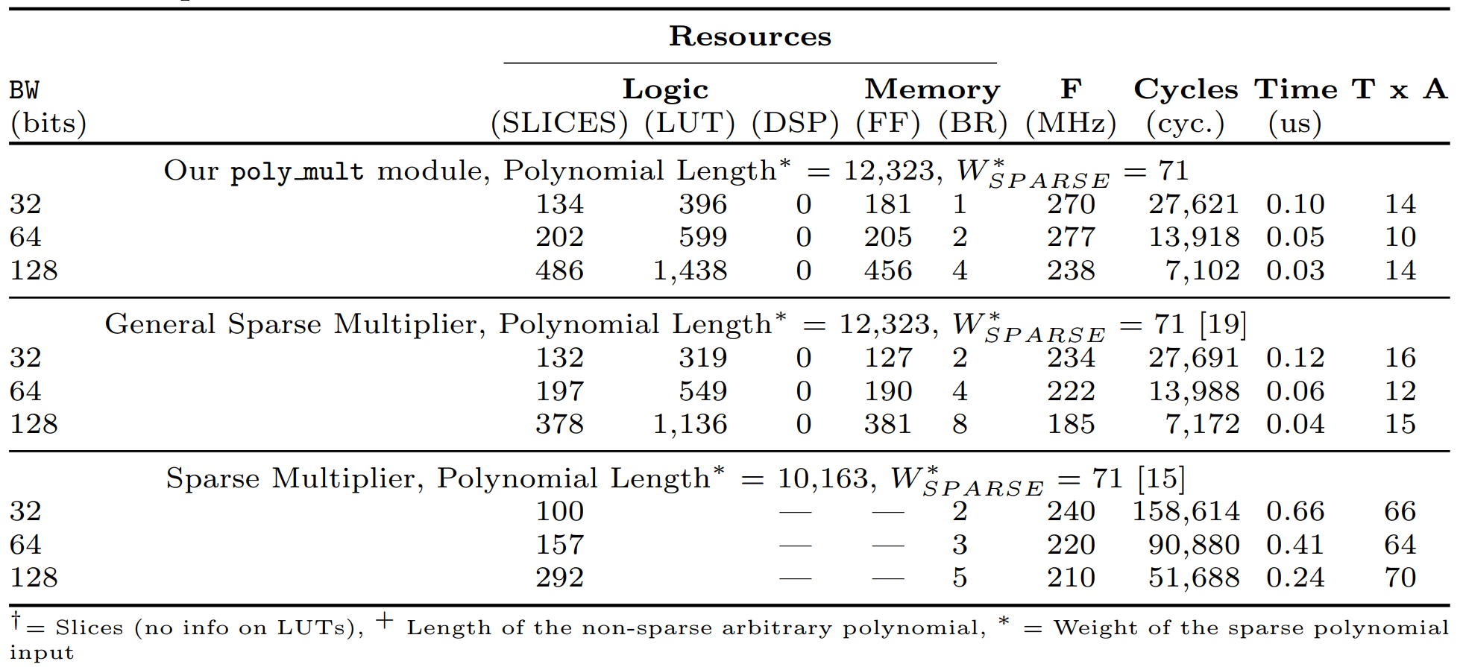
Polynomial Multiplication - Results
+
+
+
Target Device: Artix 7 – xc7a200t

Slide 20
Fixed Weight Vector Generation
Generates a uniform random n-bit fixed-weight (w) vector.
Algorithm given in [AAB+20].
Input: N, w, seed
Output: w distinct elements in range 0 to N − 1
1: pos = []*w
2. i,j,k,l = 0
3. prng_init(seed)
4: while (i < w) do
5: rand_bits ← prng_draw(outsize = 24)
6: if (rand_bits < THRESHOLD_VALUE) then
7: pos [i] = (rand bits % N)
8: i++
9: end
10: end while
//Value for THRESHOLD is a constant based on the parameter set
11: while (j < w) do
12: while (k < w) do
13: if pos[j] == pos[k] then
14: while (l < 1) do
15: rand_bits ← prng_draw(outsize=24)
16: if (rand_bits < THRESHOLD) then
17: pos [k] = (rand_bits % N)
18: l++
19: end if
20: end while
21: end
22: else then
23: k++
24: end
25: end while
26: j++
27: end while
28: return pos
Guo et. al [GHJ+22] demonstrated a timing attack on the software reference implementation
RNG
Threshold Check
Duplicate Detection

Slide 21
Fixed Weight Vector – Constant Weight Word (CWW) Method
Constant time method proposed by Sendrier [SEN21].
Recommended by HQC Team as a 4th round update.
Barrett Reduction used in Index Generation.
However, this method has small bias.
Input: N, w, seed
Output: w distinct elements in range 0 to N − 1
1: rand bits ← prng(input = seed, output size = 32 × w)
2: for i ← w − 1 to 0 do
3: pos[i] = i + (rand bits[32 + 32 ∗ i − 1 : 32 ∗ i])%(N − i)
4: end for
5: for j ← w − 1 to 0 do
6: duplicate found ← 0
7: for k ← j + 1 to w − 1 do
8: if pos[j] == pos[k] then
9: duplicate found ← 1
10: end if
11: end for
12: if duplicate found == 1 then
13: pos[j] = j
14: end
15: end for
16: return pos
RNG
Index Generation
Duplicate Detection and Index Replacement

Slide 22
Fixed Weight Vector Generation – Fast and Non-Biased(FNB) Method
Small prob non-constant time behavior
Improvement on the original algorithm proposed given in [AAB+20]
Input: N, w, seed, ACC_REJ
Output: w distinct elements in range 0 to N − 1
1: pos = []*(w + ACC_REJ)
2. i,j,k,m = 0
3. prng_init(seed)
4: while (i < (w+ ACC_REJ)) do
5: rand_bits ← prng_draw(outsize = 24)
6: if (rand_bits < THRESHOLD_VALUE) then
7: pos [i] = (rand bits % N)
8: i++
9: end
10: end while
//Value for THRESHOLD is a constant based on the parameter set
// ACC_REJ = ACCEPTABLE_REJECTIONS
// e.g., ACC_REJ = 75
11: while (j < w + ACC_REJ) do
12: while (k < (w+ ACC_REJ)) do
13: if (j < w) then
14: if pos[j] == pos[k] then
15: if (m<ACC_REJ) then
16: pos[k] = pos[m+w]
17: m++
18: end
19: else
20: USE PRNG TO DRAW MORE RAND BITS AND
REDO THRESHOLD CHECK and ASSIGN TO pos[k]
21: end
22: end
23 else
24: DUMMY OPERATIONS
25 end
26: else
27: DUMMY OPERATIONS
28: end
29: k++
30: end while
31: j++
32: end while
33: return pos
RNG
Threshold Check
Duplicate Detection

Slide 23
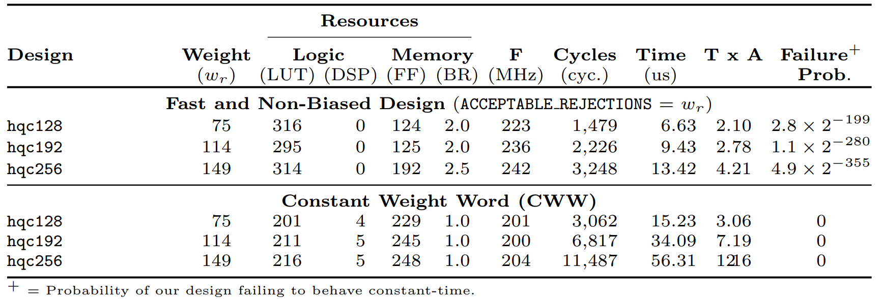
Fixed Weight Vector Generation - Evaluation

Slide 24
Key Generation - Algorithm and Hardware Design
Inputs: pk_seed, sk_seed
Outputs: public key(h, s), secret key (x, y)
(x,y) = FixedWeight(sk_seed)
h = VectorRandom(pk_seed)
s = x + h.y
1
2
3

Slide 25
Key Generation – Hardware Design Performance Comparison
HQC128
Lower is better

Slide 26
Hardware Implementation of HQC KEM
1. Key Generation
Fixed weight error vector generation
SHAKE256
Polynomial Multiplication
Polynomial Addition
3. Decapsulation
Decrypt
Decode
Polynomial Subtraction
Polynomial Multiplication
Encapsulation
2. Encapsulation
Encrypt
Encode
Polynomial Multiplication
Polynomial Addition
Fixed weight error vector generation
SHAKE256
Hash Computation
SHAKE256

Slide 27
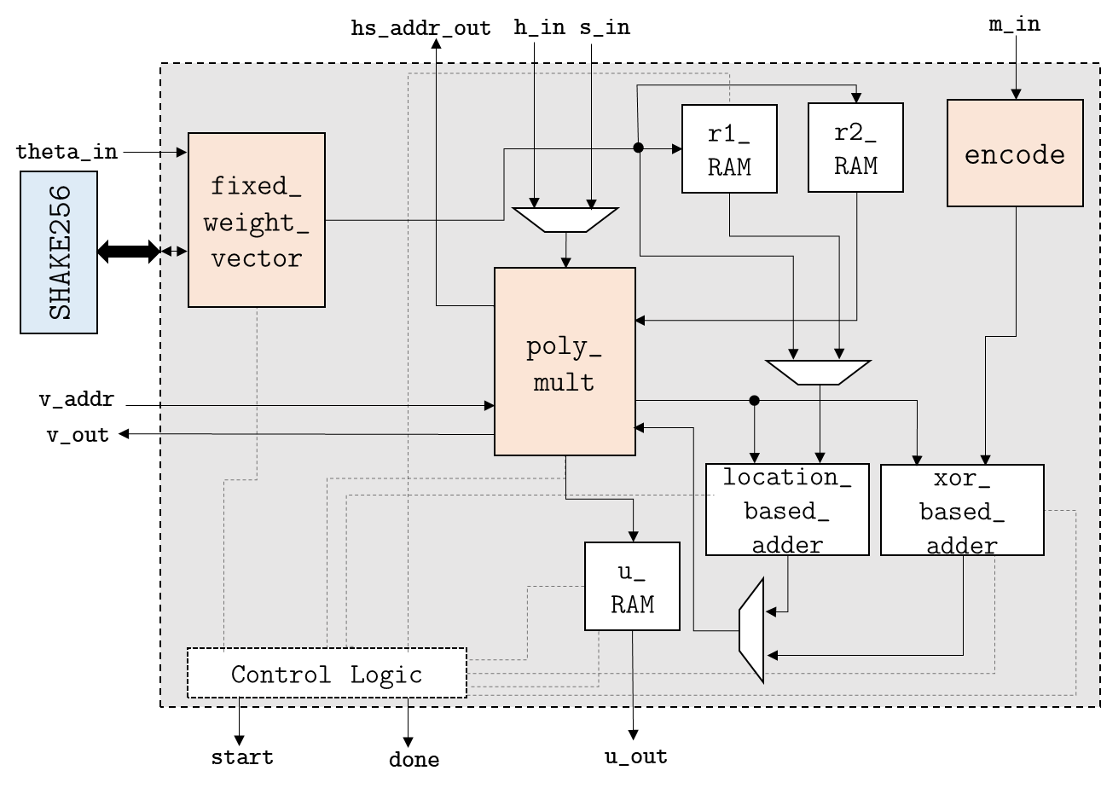
Encrypt - Algorithm and Hardware Design
1
Inputs: theta, Public Key (h_in, s_in),
message (m_in)
Outputs: Ciphertext (u_out, v_out)
u_out = r₁+h.r₂
v_out = m_in.G + S.r₂ + e
Where m_inG = Encoded message
r₁, r₂, e are fixed weight vectors
1
2
1
2
Encode consists of Reed-Solomon and Reed-Muller Encoding

Slide 28
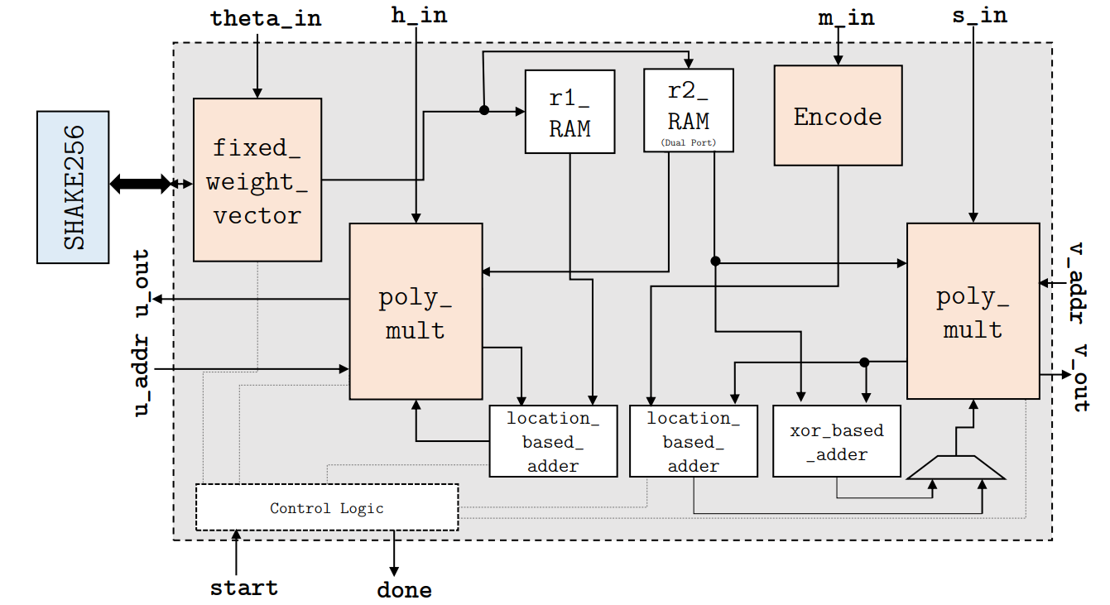
Encrypt - Algorithm and Hardware Design
Inputs: theta, Public Key (h_in, s_in),
message (m_in)
Outputs: Ciphertext (u_out, v_out)
u_out = r₁+h.r₂
v_out = m_in.G + S.r₂ + e
Where m_inG = Encoded message
r₁, r₂, e are fixed weight vectors
1
2
Two polynomial multiplications can be run in parallel.

Slide 29
Encapsulation - Algorithm and Hardware Design
1
Inputs: Public Key (h_in, s_in), message (m_in)
Outputs: Ciphertext (u_out, v_out), Shared Secret (K_out), Hashed message(d_out)
(u_out, v_out) = Encrypt(m_in)
d = Hash(m_in)
SS = Hash(m_in, u_out, v_out)
2
3

Slide 30
Encapsulation – Hardware Design Performance Comparison
HQC128
Lower is better

Slide 31
Hardware Implementation of HQC KEM
1. Key Generation
Fixed weight error vector generation
SHAKE256
Polynomial Multiplication
Polynomial Addition
3. Decapsulation
Decrypt
Decode
Polynomial Subtraction
Polynomial Multiplication
Encapsulation
2. Encapsulation
Encrypt
Encode
Polynomial Multiplication
Polynomial Addition
Fixed weight error vector generation
SHAKE256
Hash Processing
SHAKE256

Slide 32
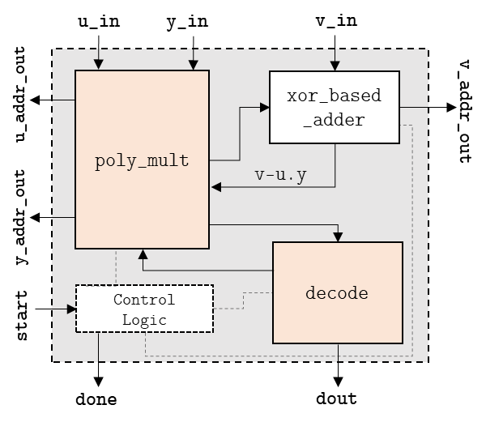
Decrypt - Algorithm and Hardware Design
Inputs: Secret Key (y_in), Ciphertext (u_in,v_in)
Outputs: Decoded Message (dout)
v_minus_uy = v_in - u_in.y_in
dout = Decode(v_minus_uy)
2
1
Decode consists of Reed-Muller and Reed-Solomon decoding

Slide 33
Decapsulation
Inputs: Public Key(h_in, s_in), Secret Key (y_in), Ciphertext (u_in, v_in), Hashed message (d_in)
Outputs: Shared Secret (K_out)
m' = Decode(v_in - u_in.y_in)
d'= Hash(m’)
Verify d_in == d'?
(u', v') = Encrypt(m’)
Verify (u', v') == (u_in, v_in)?
K_out = Hash(m', u_in, v_in)
2
4
5
6
1
3
Decapsulation uses a tweaked version of Encapsulation module where uprime and vprime could be swapped with u_in and v_in.

Slide 34
Decapsulation – Hardware Design Performance Comparison
HQC128
Lower is better

Slide 35
Joint Design – Comparison with other HQC Designs
Joint Design – combines KeyGen, Encap, and Decap in to one.
Shared module among different primitives.
SHAKE256
Polynomial Multiplication
Encapsulation
Polynomial Addition
Time = KeyGen + Encap + Decap.
HQC128
Lower is better

Slide 36
Comparison with other Code Based Schemes - Key Generation
128-bit Security Level
Hardware Design
Lower is better
B - Balanced
HS – HighSpeed

Slide 37
Comparison with other Code Based Schemes - Encapsulation
128-bit Security Level
Hardware Design
Lower is better
B - Balanced
HS – HighSpeed

Slide 38
Comparison with other Code Based Schemes - Decapsulation
128-bit Security Level
Hardware Design
Lower is better
B - Balanced
HS – HighSpeed

Slide 39
Summary
First (hand-tailored) hardware implementations of HQC Key Encapsulation Mechanism parameterizable at compile-time across all parameter sets.
HQC can be a competitive candidate when optimized hardware is developed.

Slide 40
References
[AAB+20] Carlos Aguilar Melchor, Nicolas Aragon, Slim Bettaieb, Loïc Bidoux, Olivier Blazy, Jean-Christophe Deneuville, Philippe Gaborit, Edoardo Persichetti, Gilles Zémor, and Jurjen Bos. HQC. Technical report, National Institute of Standards and Technology, 2020. available at https://pqc-hqc.org/doc/hqc-specification_2021-06-06.pdf
[MDD+22] Carlos Aguilar-Melchor, Jean-Christophe Deneuville, Arnaud Dion, James Howe, Romain Malmain, Vincent Migliore, Mamuri Nawan, and Kashif Nawaz. Towards automating cryptographic hardware implementations: a case study of hqc. Cryptology ePrint Archive, Paper 2022/1425, 2022. https://eprint.iacr.org/2022/1425.
[CCD+22] Po-Jen Chen, Tung Chou, Sanjay Deshpande, Norman Lahr, Ruben Niederhagen, Jakub Szefer, and Wen Wang. Complete and improved FPGA implementation of Classic Mceliece. IACR Transactions on Cryptographic Hardware and Embedded Systems, 2022(3), 2022.
[RBCGG21] Jan Richter-Brockmann, Ming-Shing Chen, Santosh Ghosh, and Tim Güneysu. Racing bike: Improved polynomial multiplication and inversion in hardware. IACR Transactions on Cryptographic Hardware and Embedded Systems, 2022(1):557–588, Nov. 2021.
[GHJ+22] Qian Guo, Clemens Hlauschek, Thomas Johansson, Norman Lahr, Alexander Nilsson, and Robin Leander Schröder. Don’t reject this: Key-recovery timing attacks due to rejection-sampling in hqc and bike. IACR Transactions on Cryptographic Hardware and Embedded Systems, 2022, Issue 3:223–263, 2022.
[HWCW19] Jingwei Hu, Wen Wang, Ray C.C. Cheung, and Huaxiong Wang. Optimized polynomial multiplier over commutative rings on fpgas: A case study on bike. In 2019 International Conference on Field-Programmable Technology (ICFPT), pages 231–234, 2019.
[ZZY+21] Zhong, Han-Sen & Deng, Yu-Hao & Qin, Jian & Wang, Hui & Chen, Ming-cheng & Peng, Li-Chao & Luo, Yi-Han & Wu, Dian & Gong, Si-Qiu & Su, Hao & Hu, Yi & Hu, Peng & Yang, Xiao-Yan & Zhang, Weijun & Li, Hao & Yuxuan, Li & Jiang, Xiao & Gan, Lin & Yang, Guangwen & Pan, Jian-Wei. (2021). Phase-Programmable Gaussian Boson Sampling Using Stimulated Squeezed Light
[SEN21] Sendrier, Nicolas, Secure sampling of constant-weight words – application to bike. Cryptology ePrint Archive, Paper 2021/1631 (2021), https://eprint.iacr.org/2021/1631.pdf
[SFW21] Schöffel, Maximilian, Feldmann, Johannes, Wehn, Norbert. (2023). Code-based Cryptography in IoT: A HW/SW Co-Design of HQC. 10.48550/arXiv.2301.04888.
.

Slide 41

Summary
First (hand-tailored) hardware implementations of HQC Key Encapsulation Mechanism parameterizable at compile-time across all parameter sets.
HQC can be a competitive candidate when optimized hardware is developed.
Thank you!
Questions?
Link to the code base

